Slide 1
CHAPTER 5
Selecting Research Participants

Slide 2
Selecting Participants
The selection of research participants is a critical issue in research planning
Why?

Slide 3
Definitions
Sampling – The process of selecting observations from a population
Population == All members of a particular group

Slide 4
Why Sample?
Populations vary greatly in size
  Small population?
  Large population?
For most psychologists, our target population is all people.
Cannot measure all people!

Slide 5
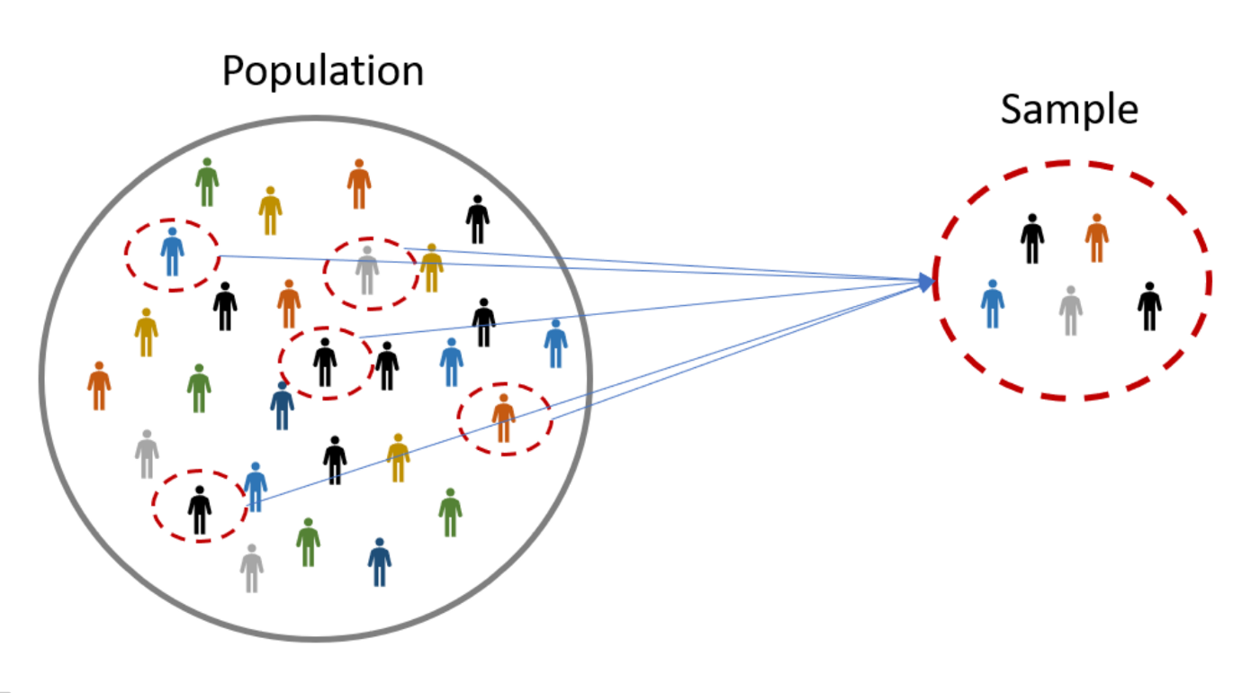

Slide 6
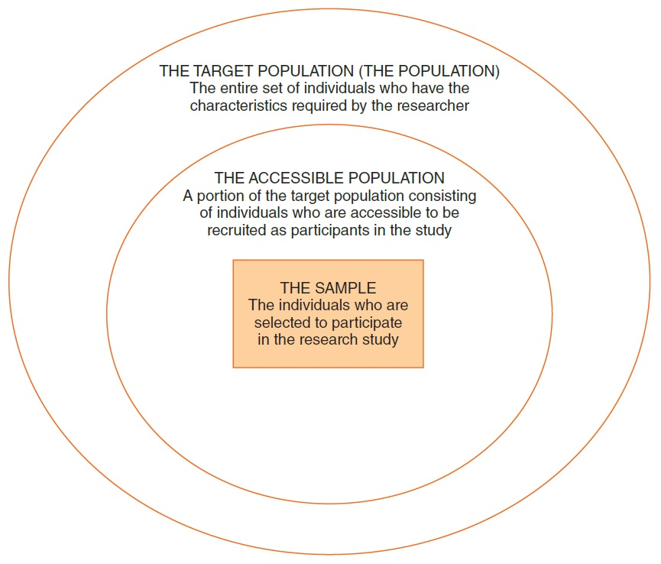
Notes:
Figure 5.2 The Relationship Among the Target Population, the Accessible Population, and the Sample

Slide 7
Sampling Considerations
Who is your sample?
Where will you recruit them from?
Do they accurately reflect the population?

Slide 8
Sampling Considerations
Bad sample == inaccurate results
  Potentially miss an effect or find an effect that doesn’t exist in the “real world”
  What makes a bad sample?

Slide 9
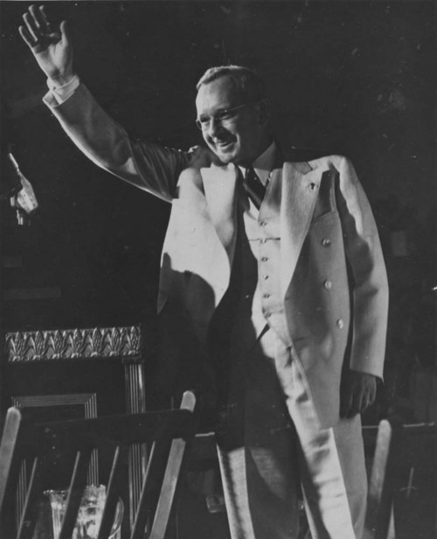
1936 Presidential Election
President Alf Landon

Slide 10
1936 Presidential Election
President Alf Landon
  Literary Digest poll, 1936
  Two million ballots mailed to people listed in telephone directory
  Ballots predicted a large Landon Victory

Slide 11
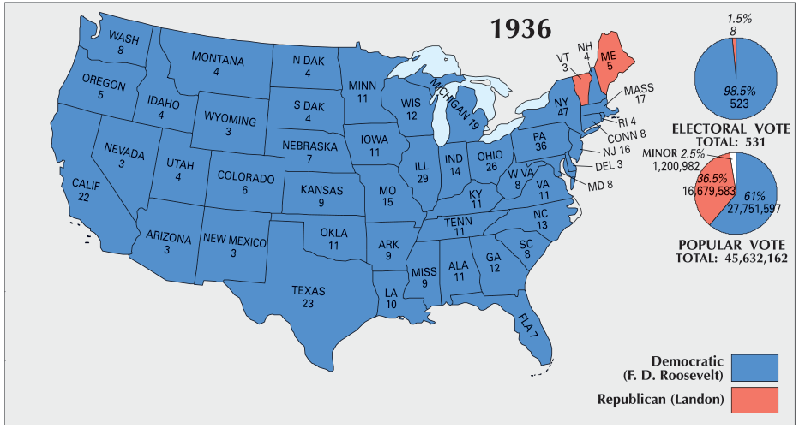
A Brief History of Sampling
President Alf Landon
  FDR won in a landslide…

Slide 12
1936 Presidential Election
What went wrong???
Pre-election polling was flawed!
  Based on the “Literary Digest Poll”
    Based on a sample of 2.7 million individuals
    Poll began in 1916
      Always predicted the correct winner!

Slide 13
1936 Presidential Election
Flawed Polling
Literary Digest primarily polled its own readers, car owners, and telephone owners
  Wealthy!
Selection (sampling) bias!
  Most people voting for FDR didn’t respond to the poll!

Slide 14
1948 Presidential Election
Thomas Dewey vs. Harry S Truman
Dewey predicted to win in a landslide

Slide 15
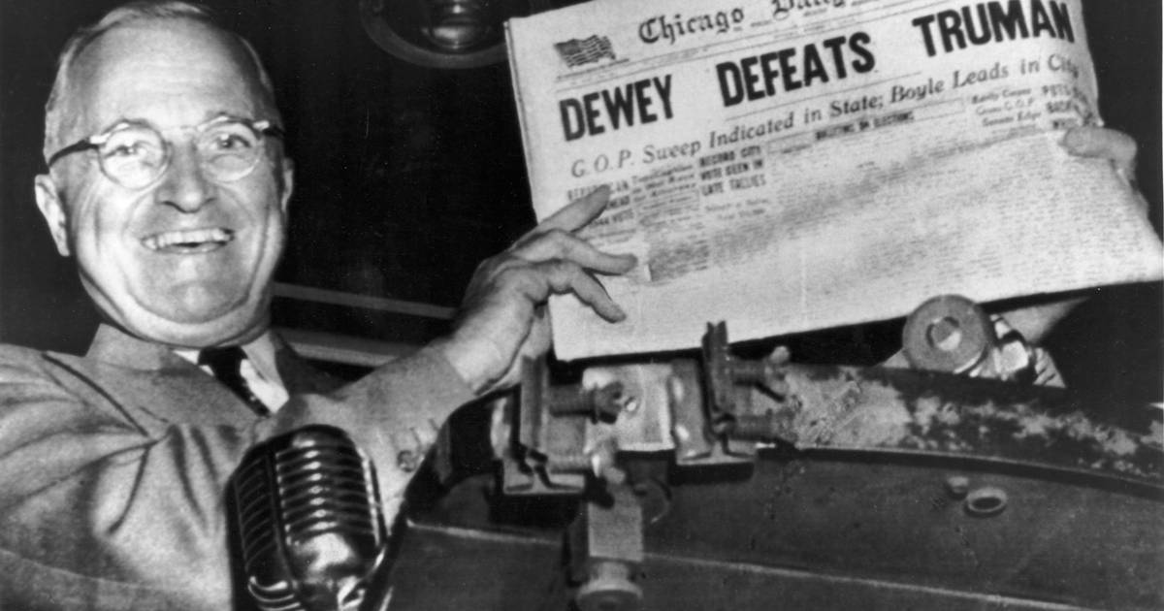
1948 Presidential Election
“President” Thomas E. Dewey
  Gallup’s quota sampling
  Problems?

Slide 16
1948 Presidential Election
Gallup’s quota sampling
Quota frames were based on 1940 census
  Urban migration during WWII
  Underrepresented urban masses
Stopped polling in October 1948 (~ 1 month before election day)

Slide 17
Sample Size (1 of 2)
Researcher’s goal ► select a sample that is representative of the population.
Law of large numbers: a large sample will probably be more representative than a small sample.
A sample size of 25-30 individuals for each group or treatment condition is a good target for many studies.

Slide 18
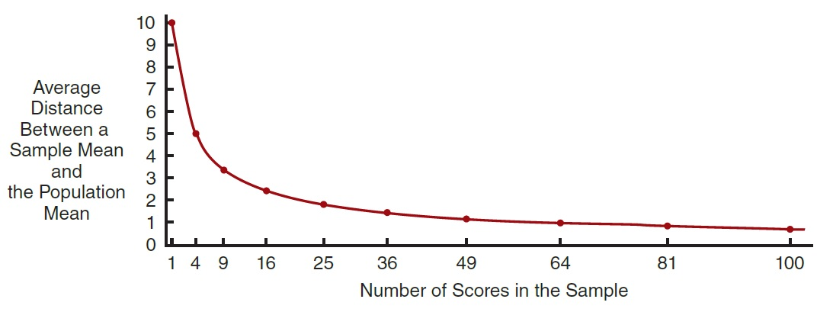
Sample Size (2 of 2)
Notes:
Figure 5.3 The Average Distance between a Sample Mean and the Population Mean as a Function of Sample Size
Note that the larger the sample, the more accurately the sample represents the population. However, representativeness increases in relation to the square root of the sample size.

Slide 19
Sampling Basics
Two basic categories of sampling methods
  Probability sampling
    The exact size of the population must be known and it must be possible to list all the individuals.
    Each individual in the population must have a specified probability of selection.
    The selection process must be unbiased; must be a random process.
  Nonprobability sampling: odds of selecting a particular individual are unknown.

Slide 20
Nonprobability Sampling
Nonprobability Sampling – Any technique in which samples are selected in some way not suggested by probability theory.
  Available subjects (convenience sampling)
  Quota sampling

Slide 21
Nonprobability Sampling
Reliance on Available Subjects
  Does not allow for control over representativeness.
  Only justified if less risky methods are unavailable.
  When might this method be appropriate?

Slide 22
Nonprobability Sampling
Quota Sampling – Participants are selected based on pre-specified characteristics
  Total sample will have the same distribution of characteristics assumed to exist in the population being studied.
  Similar to probability sampling, but has problems
    quota frame must be accurate, selection of sample elements may be biased!

Slide 23
Sampling techniques
If all members of a population were identical in all respects, there would be no need for careful sampling procedures.
Not the case! Lots of individual differences!
A sample of individuals from a population must contain the same variations that exist in the population.

Slide 24
Sampling bias
Need to be aware of Conscious and Unconscious Sampling Bias!
  Bias – Those selected are not typical nor representative of the larger population.

Slide 25
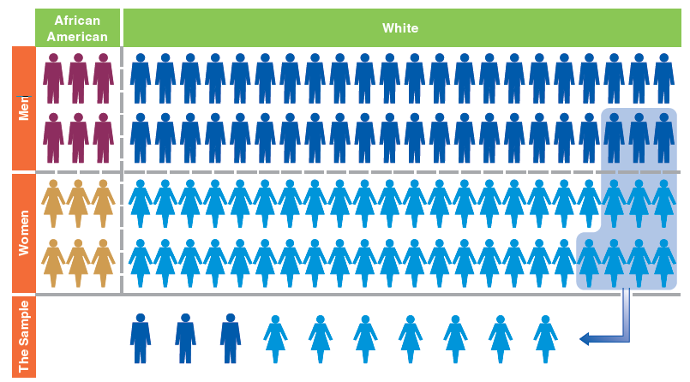
Is this a good sample?

Slide 26
Representativeness
A good sample is representative of the population
  Representativeness – Sample has the same distribution of characteristics as the population from which it was selected.
  Samples need not be representative in all respects, only those relevant to the research!

Slide 27
Probability Sampling
  A sample will be representative of the population from which it is selected if all members of the population have an equal chance of being selected in the sample.
  How can we ensure equal chance?

Slide 28

Probability Sampling
Random selection!
  Ensures that each member of population has equal chance of being selected
Enough people == representative!

Slide 29
Probability Sampling
  Statistic – the summary description of a variable in a sample, used to estimate a population parameter.
    We can use statistics to make inferences about population based on our sample
  Sampling Error – The degree of error to be expected of a given sample design.
    No sample will perfectly represent population!

Slide 30
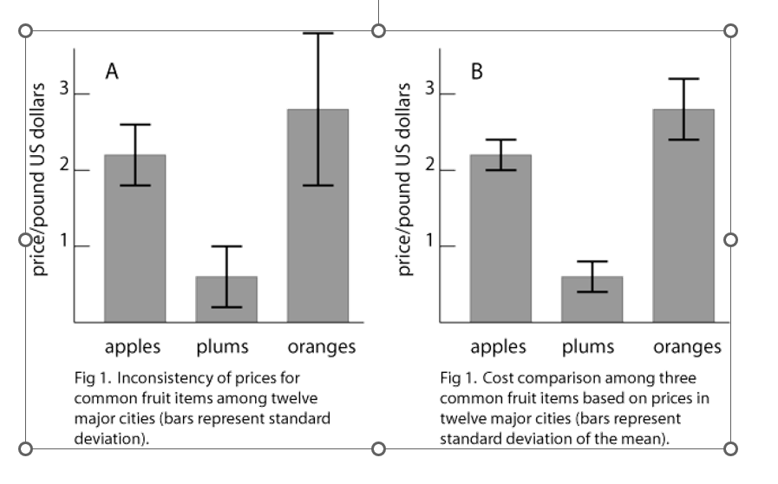
Sampling Error

Slide 31
Types of Sampling Designs
Simple Random Sampling – Units of a population are assigned numbers. Random numbers are generated and the units having those numbers are included in the sample.
Downsides:
  Not necessarily the most accurate sampling method.
  Requires access to all members of your population

Slide 32
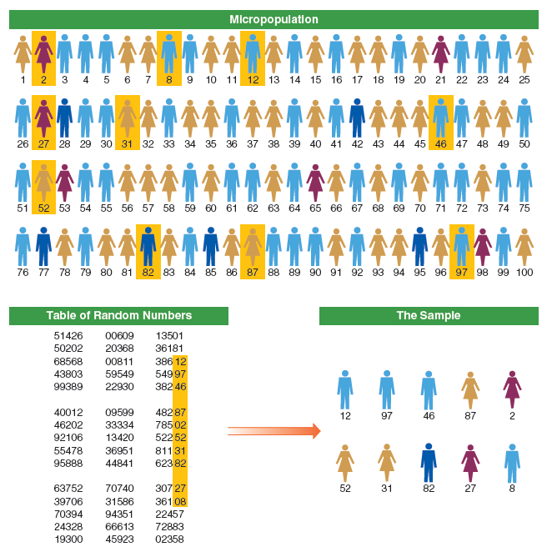

Slide 33
Types of Sampling Designs
Systematic Sampling – A type of probability sampling in which every k^{th} unit in a list is selected for inclusion in the sample.
  Example: Every third person
  Slightly more accurate than simple random sampling.
  Again, need to know your whole population

Slide 34
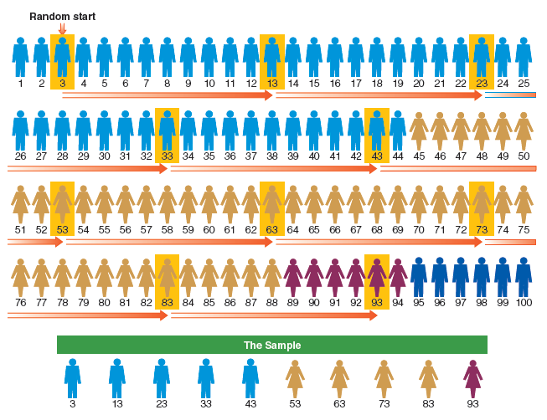

Slide 35
What do we do in psych?
Convenience sampling!
  Who is our population? What members of our population do we actually have access to?
  Potential problems w/ representativeness
Potentially good if you don’t have access to whole population!

Slide 36
Convenience sampling
How to ensure representativeness?
  Sample from a large group! Make sure that all group members have equal access
    Example: All undergrads in PSYC 1103 can take this study
  For experimental research: Randomly assign participants to conditions!

